Slide 1




XAMPP
Setup a PHP + MySQL Development Environment
XAMPP
SoftUni Team
Technical Trainers
Software University
http://softuni.bg

Slide 2



Table of Contents
What is XAMPP
Installing and Configuring XAMPP on Windows
PHP IDEs
phpStorm, Eclipse, NetBeans
Debugging PHP with Xdebug
Configuring Xdebug

Slide 3
Have a Question?
sli.do #soft-tech

Slide 4
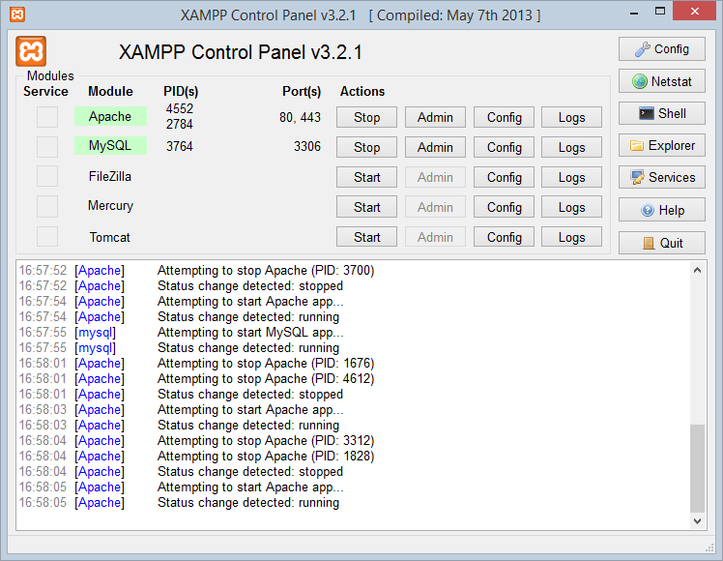

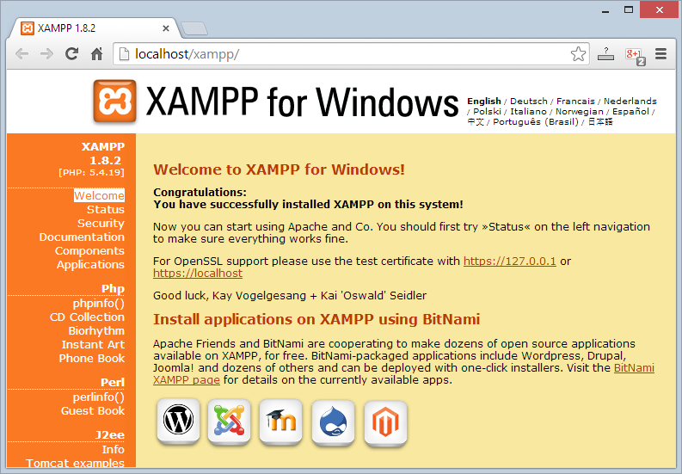
XAMPP
Install and Configure XAMPP

Slide 5
What is XAMPP?
XAMPP (/ˈzæmp/ or /ˈɛks.æmp/)
PHP + MySQL + Apache + tools
Free, open source software package
Runs on Windows, Linux and Mac OS X
Apache Web server + OpenSSL
MySQL database + phpMyAdmin
Scripting languages: PHP and Perl
Admin panel for simplified administration

Slide 6
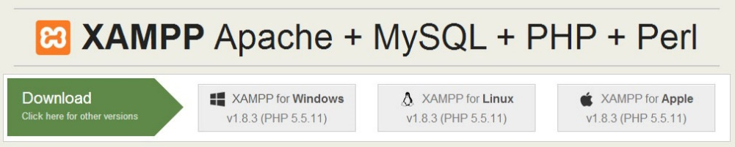
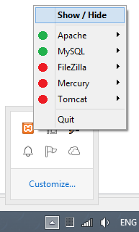
Download, Install and Run XAMPP
Downloading XAMPP:
https://www.apachefriends.org/download.html
Installing XAMPP for Windows:
Download the installer (run it as administrator)
Usual Windows installation: Next -> Next -> Finish
Running XAMPP
XAMPP start as a tray icon

Slide 7
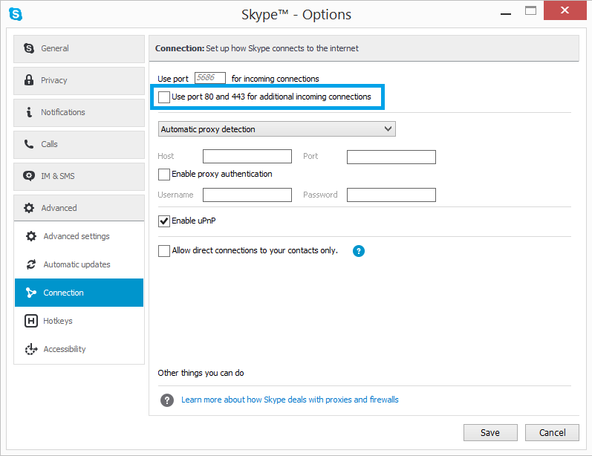
XAMPP: Collision with Skype

Slide 8
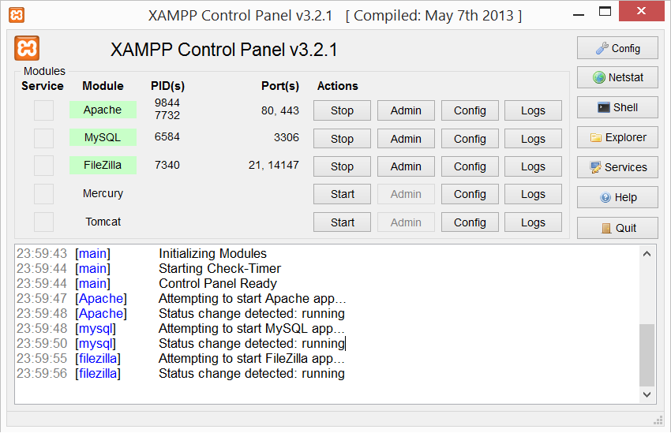
XAMPP Control Panel
Used TCP ports
Windows process IDs
System messages (logs)

Slide 9
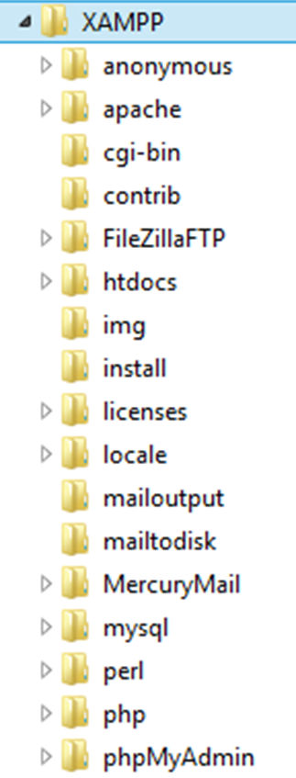
XAMPP Directories
Location of public HTML files (document root)
./htdocs
Location of Apache Web server
./apache
Location of PHP interpreter
./php
Location of MySQL database server
./mysql

Slide 10

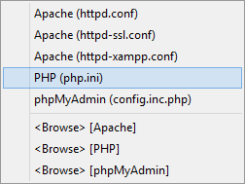

XAMPP Configuration Files
Apache configuration file (httpd.conf)
.\apache\conf\httpd.conf
PHP configuration file (php.ini):
.\apache\bin\php.ini
MySQL configuration file (my.cnf):
.\mysql\bin\my.cnf

Slide 11
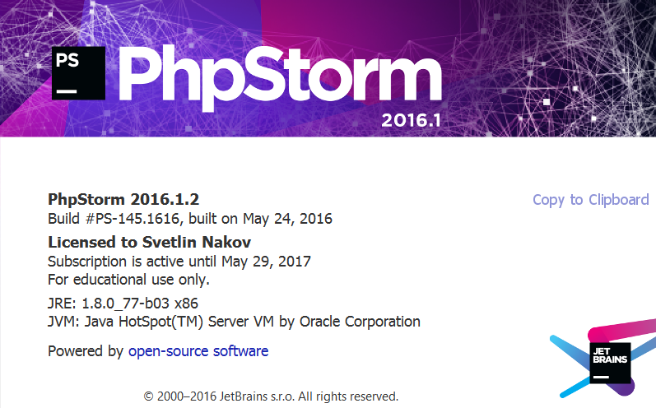


PHP IDEs
PHP Storm, NetBeans, Eclipse, …

Slide 12
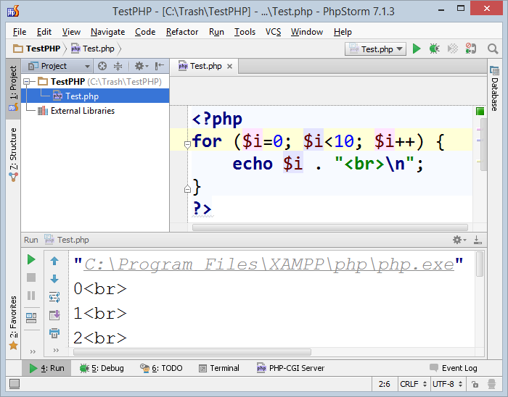
PHP Storm
PHP Storm
Powerful PHP IDE
By JetBrains, paid product
Built-in Web server for simplified configuration
Easy to install and configure
Debugger (Xdebug support)
http://jetbrains.com/phpstorm/

Slide 13
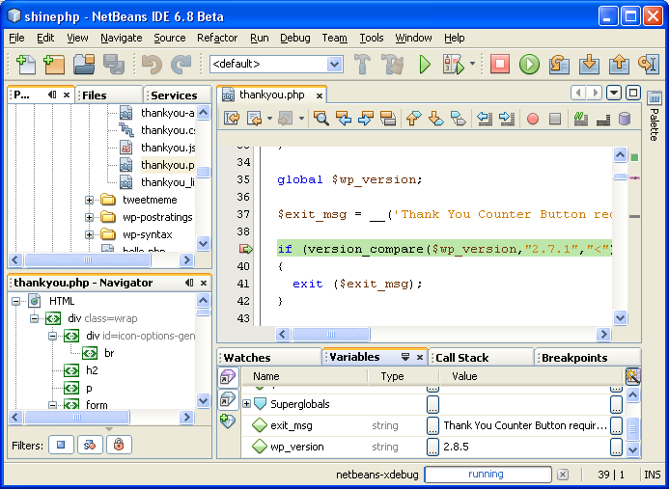
NetBeans for PHP
The NetBeans IDE fully supports PHP
Free, open-source IDE
PHP code editor
Debugger (through Xdebug)
Server integration
Frameworks support:
Symfony2, Zend

Slide 14
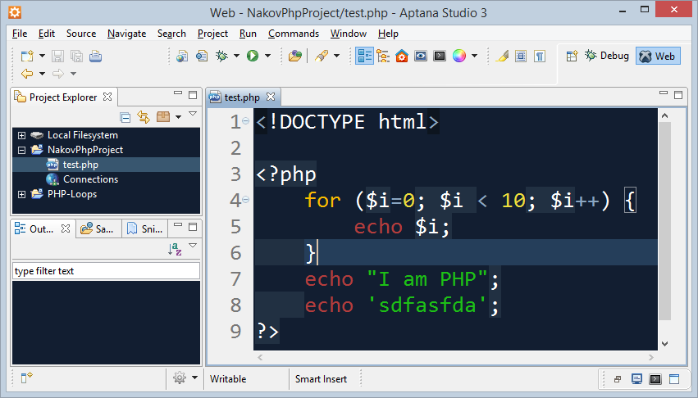
Eclipse PDT / Aptana Studio
The Eclipse platform provides solid PHP development support
PDT – PHP Development Tools
Write PHP code, Web server integration, debugging (Xdebug)
Free, open-source: http://www.eclipse.org/pdt/
Aptana Studio
Eclipse-based IDE for PHP, Ruby, Python
Supports also HTML, CSS, JavaScript
Open-source: http://www.aptana.com

Slide 15





Debugging PHP
Setup Xdebug for PHP Debugging

Slide 16
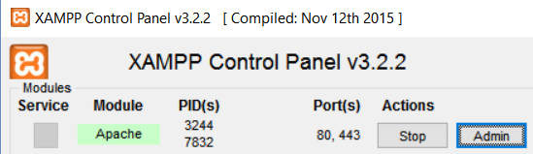
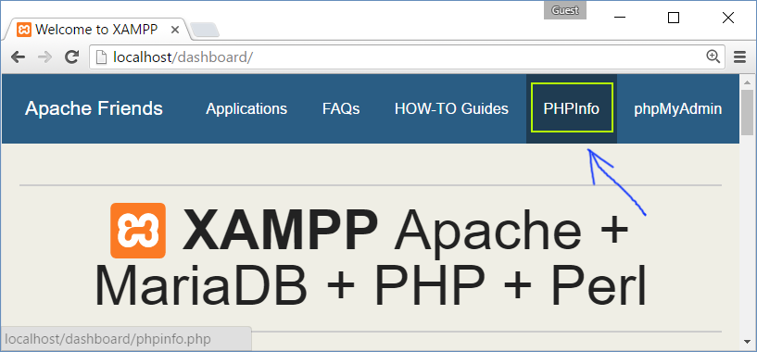
Xdebug
PHP uses Xdebug extension to enable code debugging
Check whether Xdebug is installed by phpinfo()

Slide 17
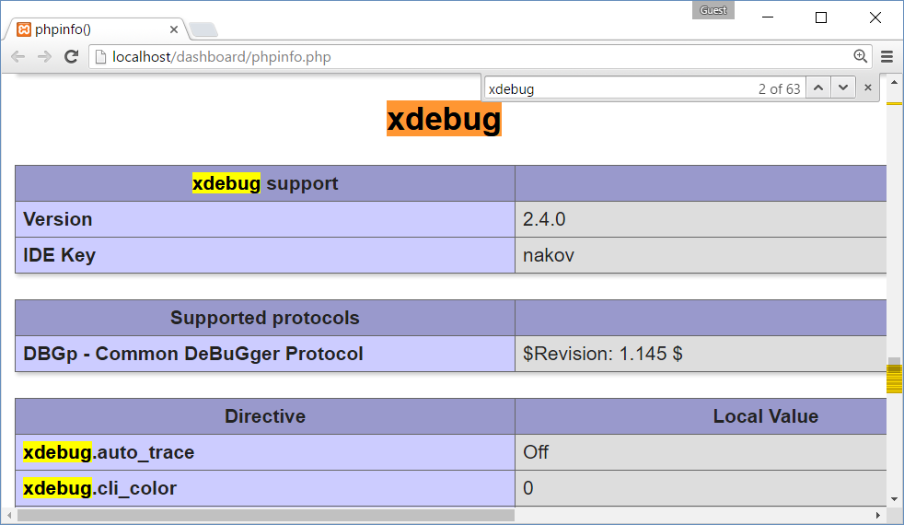
Check for Xdebug with phpinfo()
xdebug extension is shown in phpinfo()

Slide 18
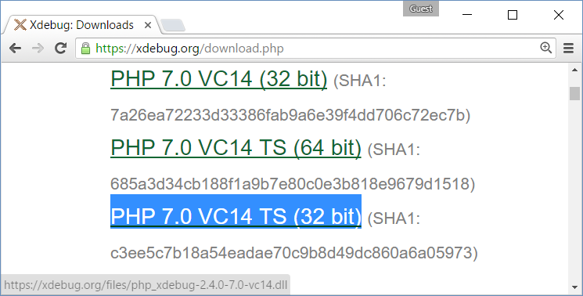
Download Xdebug
Download Xdebug for PHP 7 from https://xdebug.org
XAMPP is 32-bit, so use the 32-bit version, thread-safe (TS)
php_xdebug-2.4.0-7.0-vc14.dll
Save it in your php/ext directory, e.g. c:\xampp\php\ext

Slide 19
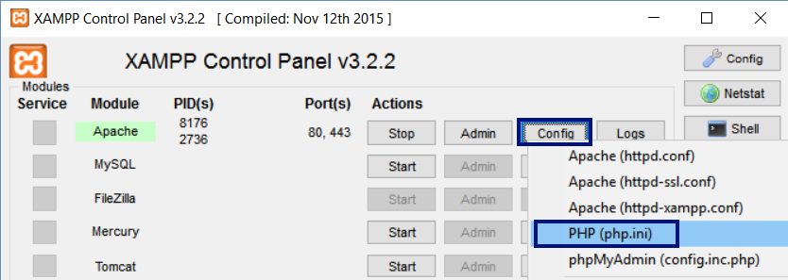
Enable the XDdebug Extension in php.ini
Add the following lines to your php.ini
Typically its is located at c:\xampp\php\php.ini
[Xdebug]
zend_extension = "C:\xampp\php\ext\php_xdebug-2.4.0-7.0-vc14.dll"
xdebug.remote_enable = 1

Slide 20
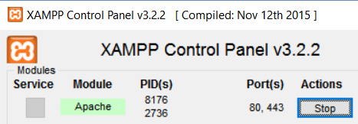
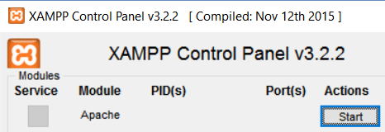
Restart Apache and Your IDE
Changes in php.ini require Apache Web server restart!
Also restart your IDE

Slide 21
Check Again for Xdebug with phpinfo()

Slide 22
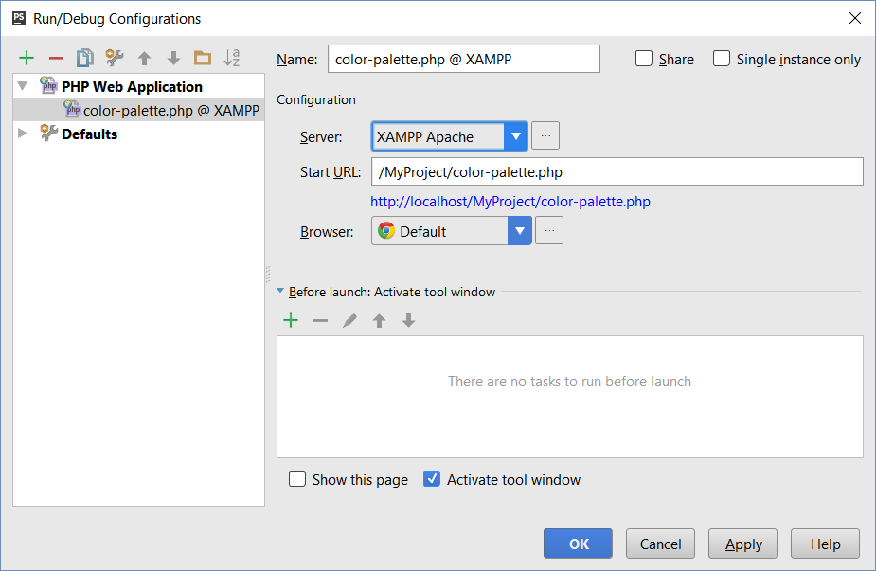
Debugging in PHP Storm
Create your project in the Apache document root
E.g. c:\xampp\htdocs\MyProject
Setup a debug configuration
Configure Apache XAMPP as Web server
Host: localhost
Port: 80

Slide 23
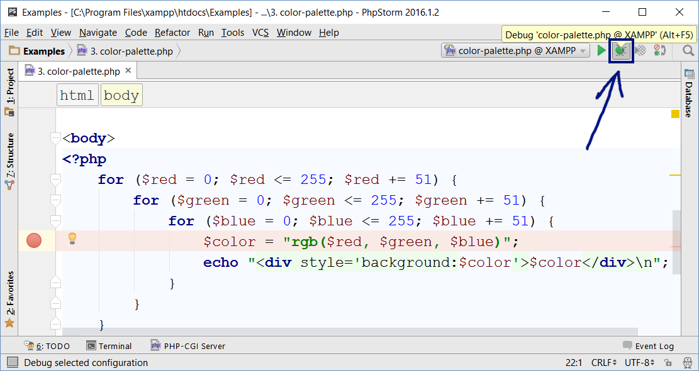
Debugging in PHP Storm (2)
Put breakpoints and run in debug mode:

Slide 24
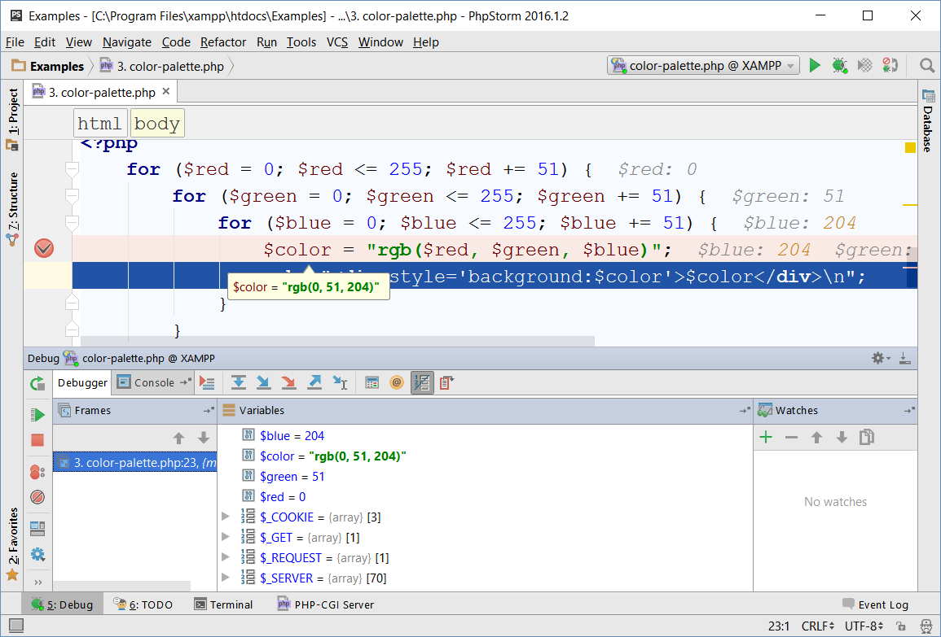
Debugging in PHP Storm (2)
Enjoy the Debugging Experience

Slide 25

Summary
XAMPP is easy-to-install package
PHP + Apache + MySQL + admin panel
PHP IDEs simplify PHP development
phpStorm, Eclipse / Aptana, NetBeans
Xdebug can debug PHP scripts
Install Xdebug extension in php.ini
Configure Xdebug in your IDE

Slide 26









XAMPP: PHP + MySQL Dev Environment
https://softuni.bg/courses/software-technologies

Slide 27
License
This course (slides, examples, demos, videos, homework, etc.) is licensed under the "Creative Commons Attribution-NonCommercial-ShareAlike 4.0 International" license

Slide 28





Trainings @ Software University
Software University Foundation – softuni.org
Software University – High-Quality Education, Profession and Job for Software Developers
softuni.bg
Software University @ Facebook
facebook.com/SoftwareUniversity
Software University Forums – forum.softuni.bg

